Slide 1
Ebook Authoring
Sritrusta Sukaridhoto, ST. Ph.D.

Slide 2
Membuat E-book
Menulis buku yang bagus
Profitable
Cover
Metadata
Book title
Author name
Desc
Menulis buku bagus lainnya
Membangun kepercayaan pembaca
Gunakan waktu sebaik mungkin
Maksimalkan distribusi buku
Some free book
Penyebaran
Pelajari best-seller buku yang serupa

Slide 3
Ebook format
http://en.wikipedia.org/wiki/Comparison_of_e-book_formats
Comic book archive (.cbr, .cbz)
Compile HTML (.chm)
DjVu (.djvu)
EPUB (.epub)
Hypertext Markup Language (.htm, .html)
iBook (.ibooks)
KF8 – Amazon kindle (.kf8)
Portable Document Format (.pdf)
Plain text files (.txt)
PostScript (.ps)

Slide 4
Software authoring
Microsoft Word
iBooks Author
Adobe inDesign
Scribus
Latex

Slide 5
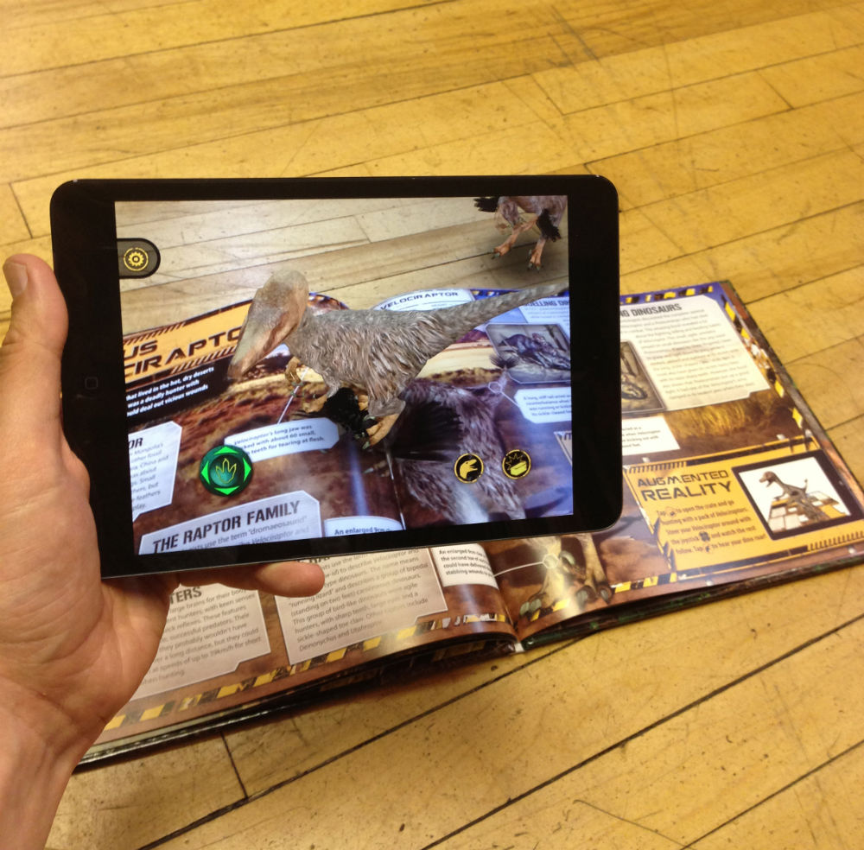
Interactive ebook
Image gallery
Quiz
Game
Multiple choice
Short answer
3D
Augmented Reality
Future
Speech recognition
Communication
Virtual reality

Slide 6
Perbandingan
 | MS Word | iBooks Author | Adobe inDesign
OS | PC, Mac | Mac | PC, Mac
Price | Rp 729.999 / tahun | free | $26 / bulan
Format | .doc, .pdf | .pdf, .ibooks | .pdf, .epub
Interactive | Yes (pdf with swf) | Yes for ibooks | Yes for epub
Multimedia | Text, image, audio, video | Text, image, audio, video | Text, image, audio, video
Portable device | Yes | Yes, Apple device | Yes
Publishing | Online/offline | Online from ibooks store | Online from adobe publishing suite

