Slide 1
Beautiful ms-word
Sritrusta sukaridhoto, st. ph.d.

Slide 2
content
Page layout
Font
Paragraph and Style
Caption
Cross-Reference
Index and tables

Slide 3
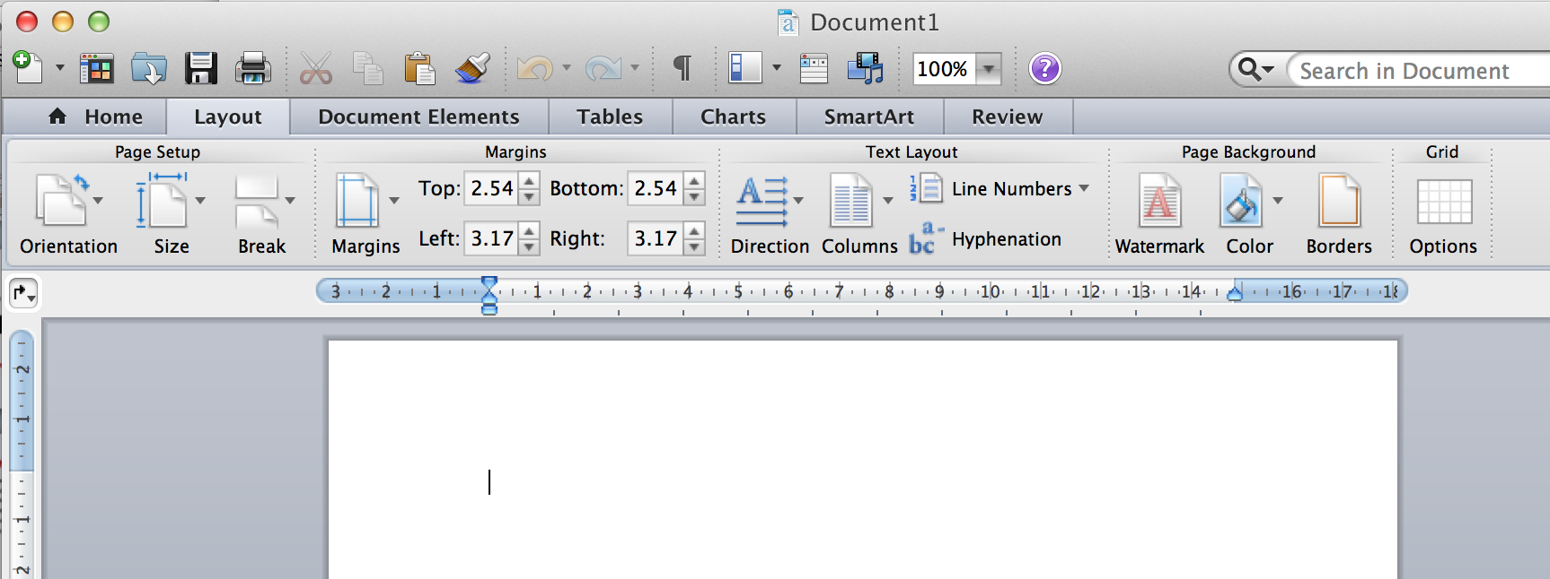
Page layout
Paper size
Page Setup : (size) A4, letter, dsb
Margins
Text Layout : Columns

Slide 4
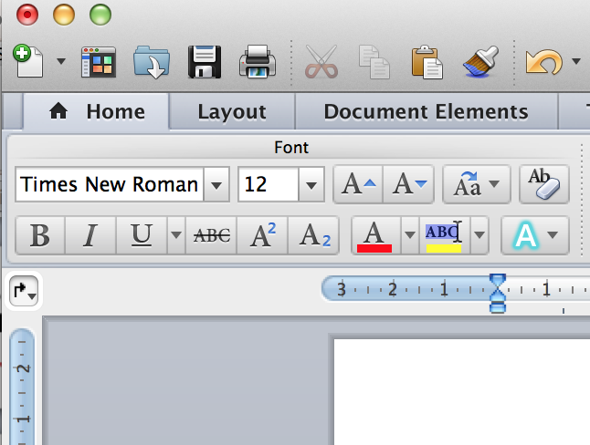
Font
Times New Roman
Title : Times New Roman 18 Bold
Section : Times New Roman 14 Bold
Sub Section : Times New Roman 12 Bold
Content : Times New Roman 12
Caption : Times New Roman 10

Slide 5
paragraph
Alignment : justified
Indenttation
Paragraph menjorok
Spacing
Jarak antar paragraph
Untuk paper menggunakan spasi 1.5

Slide 6
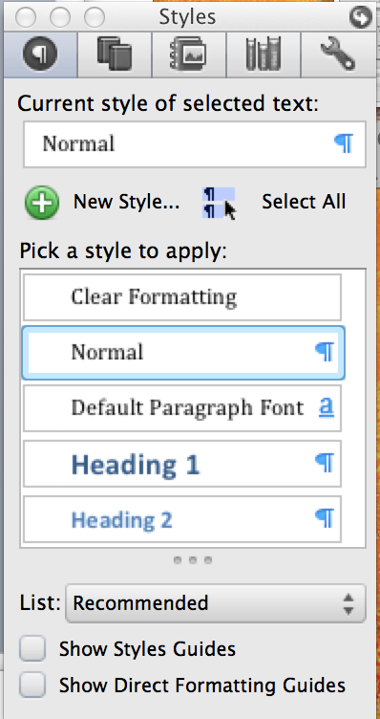
style
Clear Formating
Normal
Heading
Heading 1
Heading 2
Heading 3
Title
Caption
Reference

Slide 7
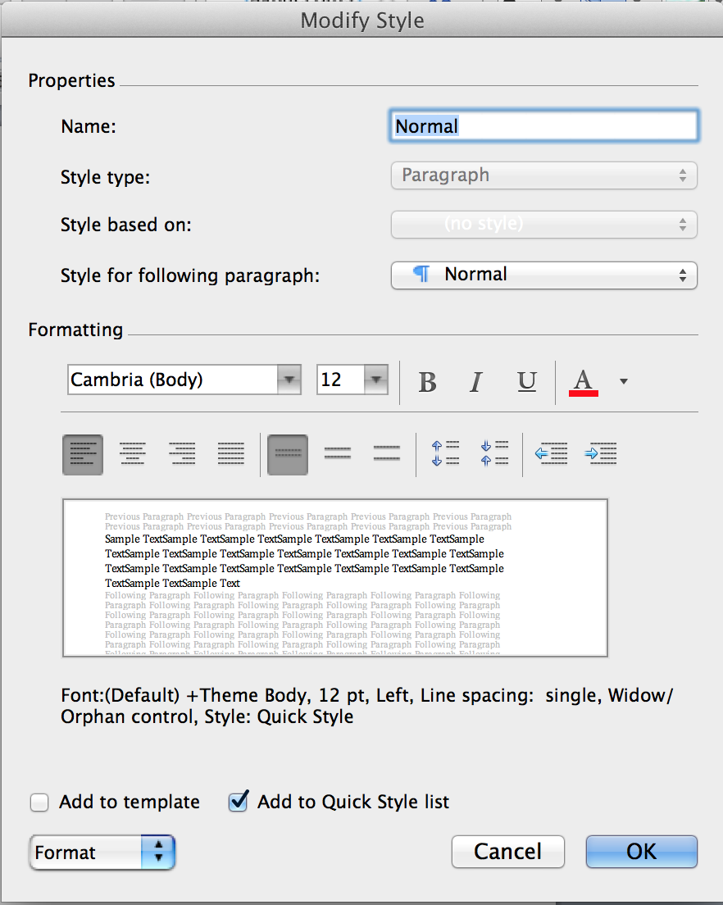
Style (2)
Properties
Name
Style type
Style based on
Style for following paragraph
Formatting
Numbering
Numbered
Outline Numbered
Paragraph

Slide 8
STYLE (3)
Konsisten terhadap style
Style →
Table of content
Table of …
Link didalam dokumen

Slide 9
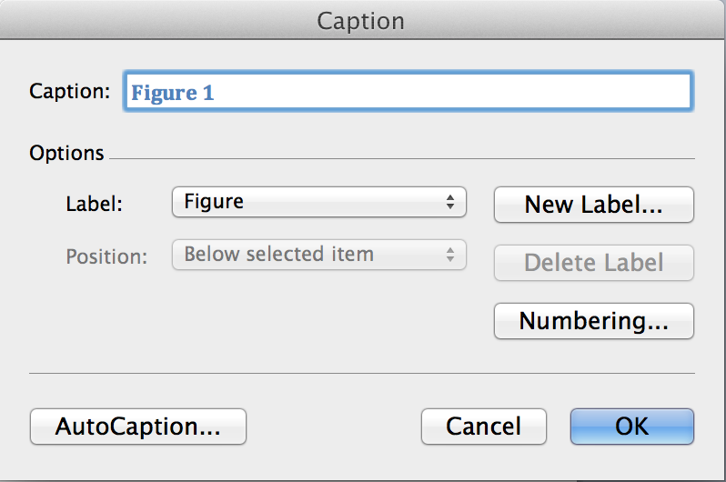
caption
Tulisan keterangan gambar atau tabel
Posisi:
Atas
Bawah
Perhatikan URUTAN!!!

Slide 10
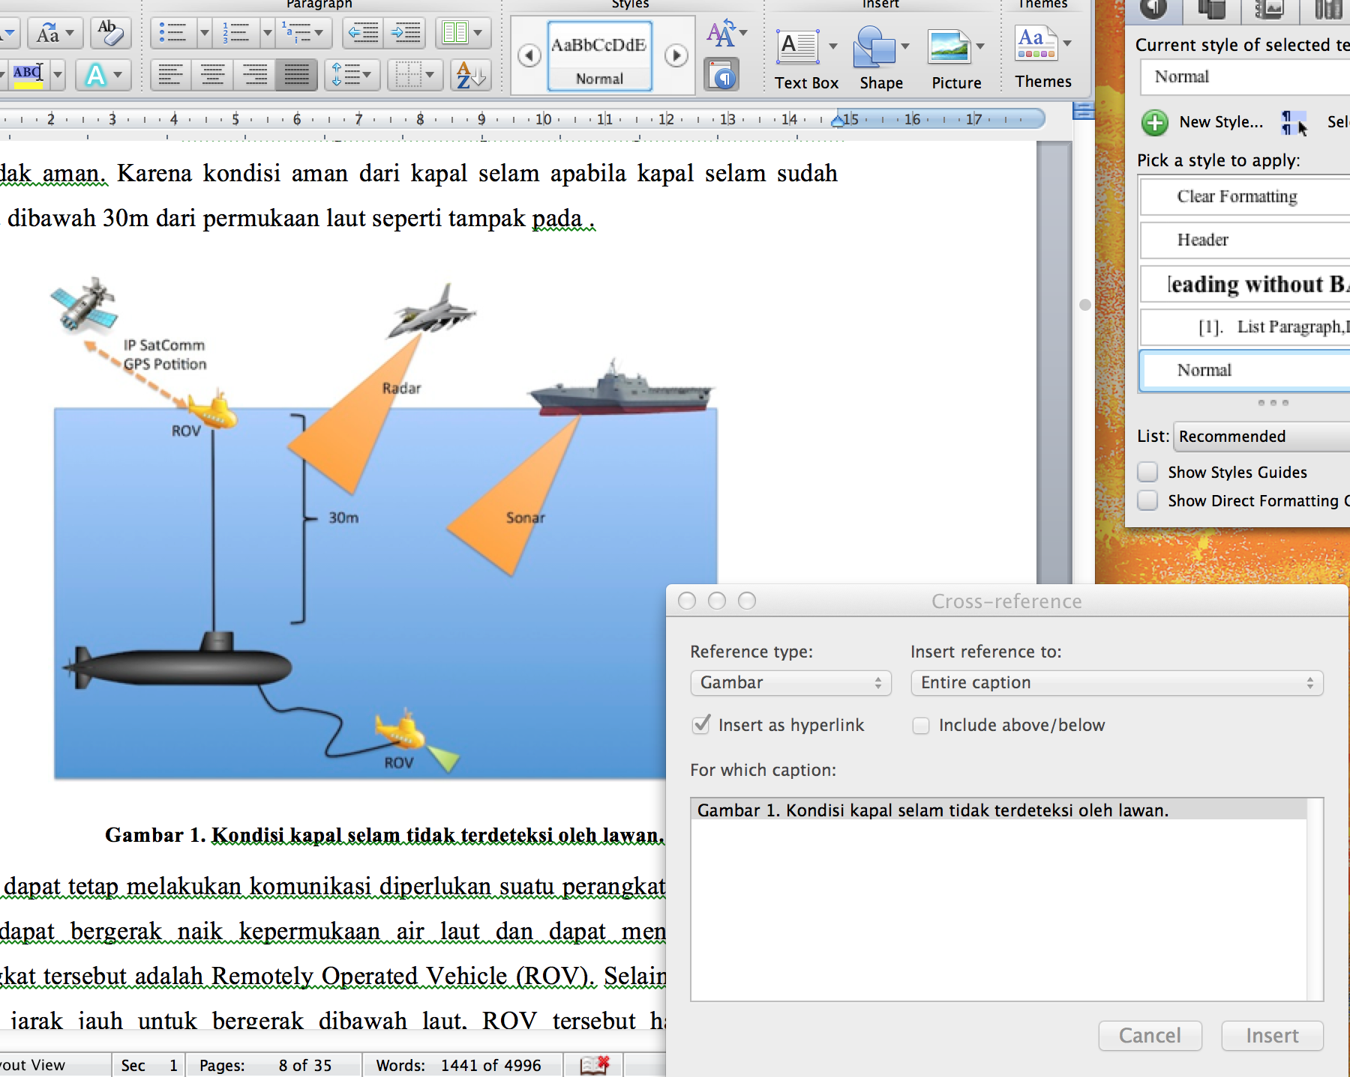
Cross reference

Slide 11
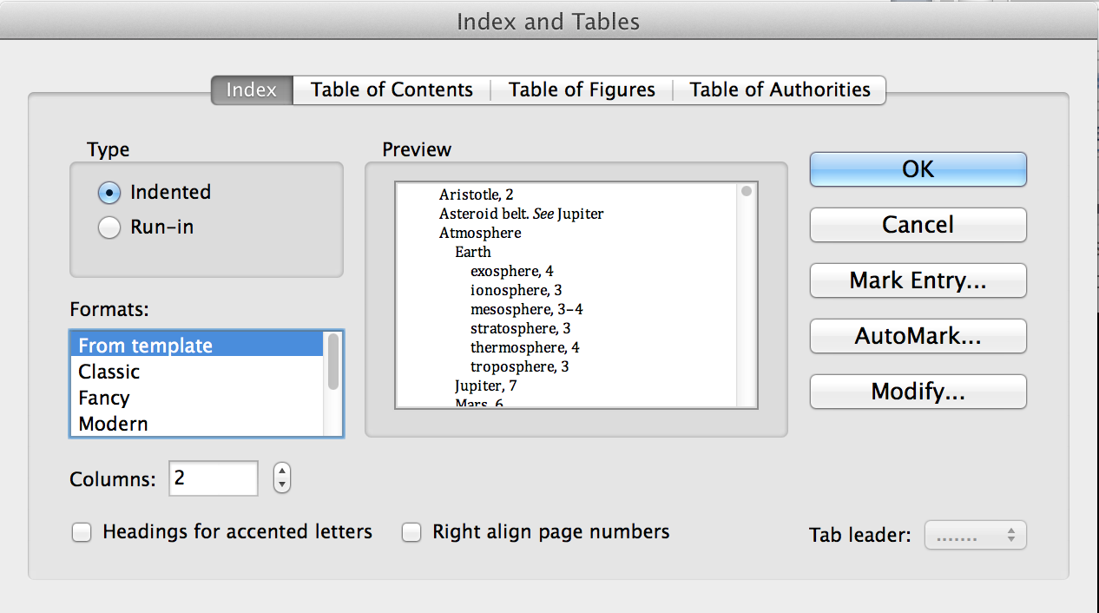
Index & tables

Slide 12
Ayo ngetik !!!

