Slide 1
HARDWARE ACCELERATED WEB BROWSER
Berlian Juliartha M.P 7408040015
Indah Yudi Suryani 7408040020
Wais Al Qonri H. 7408040028

Slide 2
HARDWARE ACCELERATED
The latest area of focus is hardware acceleration — when the browser hands off processor-intensive tasks to the computer’s graphics processor to make animations and page rendering faster and smoother.

Slide 3
HARDWARE ACCELERATED
Hardware acceleration allows the browser to offload intensive tasks like image scaling, rendering complex text or displaying scripted animations to your PC's graphics card. It has the benefit of freeing up the PC's main processor and speeding up page load times.

Slide 4
HARDWARE ACCELERATED
“Hardware acceleration” is basically using the GPU when it’s possible (instead of the CPU). This makes page-drawing operations faster.

Slide 5
There’s two different levels of acceleration going on:
Content acceleration speeds up rendering the actual page content, such as the text, images, CSS borders, etc.
Compositing acceleration speeds up putting together chunks of already-rendered content (layers) together for final display in the window, potentially applying effects such as transforms along the way. For example, if you had a HTML5 video that was playing, and it had CSS effects applied to it that was making it rotate and fade in and out, that would be using compositing acceleration to make that go fast. (This feature is not activated by default yet.)

Slide 6
HARDWARE ACCELERATED WEB BROWSER
IE9
FIREFOX 4.0 BETA 5
CHROME 7

Slide 7
IE 9
Microsoft has released Internet Explorer 9 platform, the latest pre-release version of the company’s next web browser
This version of IE9 features expanded support for specific HTML5 elements that can take advantage of the browser’s new hardware-acceleration abilities.

Slide 8
IE 9
Microsoft’s hardware acceleration tools, which rely on Direct2D and DirectWrite, are built into Windows 7, and the company is making them available to Windows Vista users (but not XP).
The new IE9 platform preview has expanded support for HTML5’s native video and audio capabilities

Slide 9
Direct 2D
Direct2D is a hardware-accelerated, immediate-mode 2-D graphics API that provides high performance and high-quality rendering for 2-D geometry, bitmaps, and text. The Direct2D API is designed to interoperate with existing code that uses GDI, GDI+, or Direct3D.

Slide 10
DirectWrite
DirectWrite is a text-layout and glyph-rendering API by Microsoft. It was designed to replace GDI/GDI+ and Uniscribe for screen-oriented rendering[citation needed] and was shipped with Windows 7 and Windows Server 2008 R2, as well as Windows Vista and Windows Server 2008 (with Platform Update installed[1] and Platform Update Supplement for Windows Vista and for Windows Server 2008(KB2117917)[2] & KB2505189[3] update installed.

Slide 11
NATIVE VIDEO
Is a video that can directly played in web video player.
For example : youtube, metacafe, etc

Slide 12

Hardware Acceleration by operating system:

Slide 13
Firefox 4
it’s available to varying degrees for Windows XP, 7, Vista, Mac OS X and Linux users
XP users get basic DirectX 9 acceleration
Vista and 7 users get Direct2D
Mac OS X Snow Leopard 10.6.3 or above you get to use OpenGL
On Windows only Intel, AMD (ATI) and nVidia graphics are supported
To enable and disable hardware acceleration in firefox
Options->advanced->check or uncheck checkbox use hardware acceleration when available

Slide 14
Chrome
Chrome 7, which is currently available in developer build form, is the latest browser to take advantage of hardware acceleration. Chrome's tightly sandboxed rendering model—which prevents web pages from interacting directly with the OS—means that hardware acceleration is a little more difficult for Google than it is for IE or Firefox.
But If you'd like to test the early builds of Chrome with hardware acceleration, you can do so now. Grab the latest developer build of Chrome 7 and launch it from the command line with the new --enable-accelerated-compositing flag.

Slide 15
Sandboxed
Sandboxed runs your programs in an isolated space which prevents them from making permanent changes to other programs and data in your computer.
In computer security, a sandbox is a security mechanism for separating running programs. It is often used to execute untested code, or untrusted programs from unverified third-parties, suppliers, untrusted users and untrusted websites.
The sandbox typically provides a tightly-controlled set of resources for guest programs to run in, such as scratch space on disk and memory. Network access, the ability to inspect the host system or read from input devices are usually disallowed or heavily restricted. In this sense, sandboxes are a specific example of virtualization

Slide 16

Comparing Hardware Accelerated SVG across Browsers with Santa’s Workshop

Slide 17
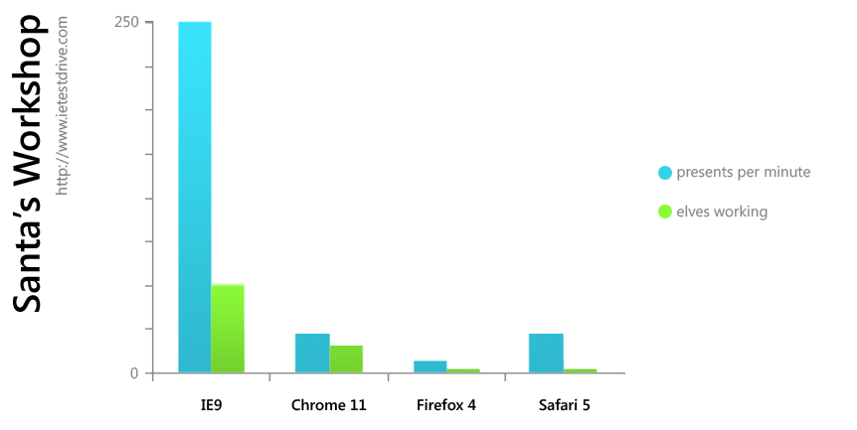
Comparing Hardware Accelerated SVG across Browsers with Santa’s Workshop

Slide 18
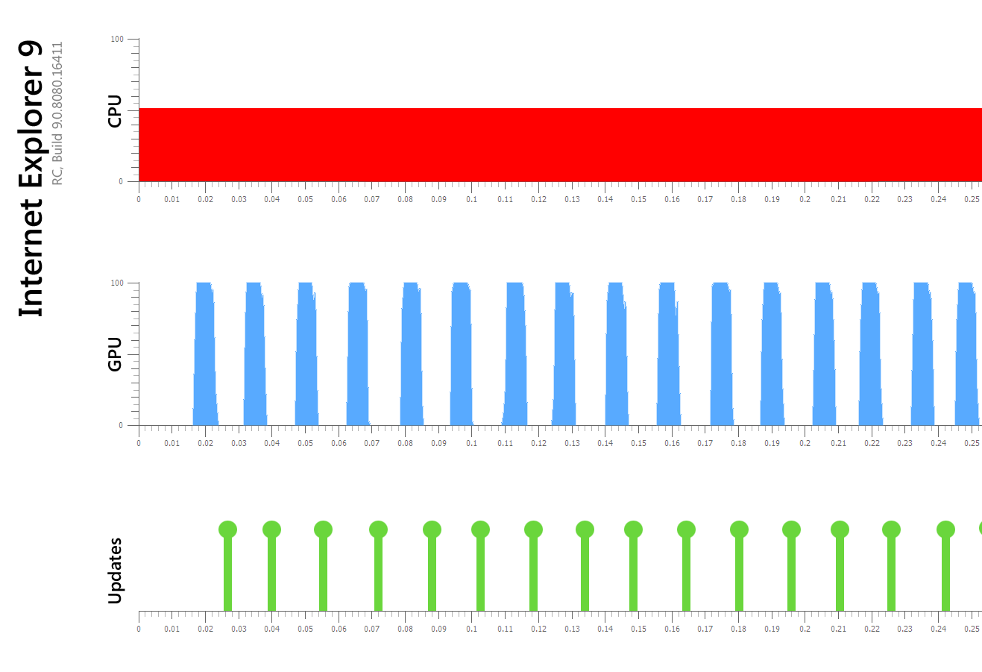
Comparing Hardware Accelerated SVG across Browsers with Santa’s Workshop

Slide 19
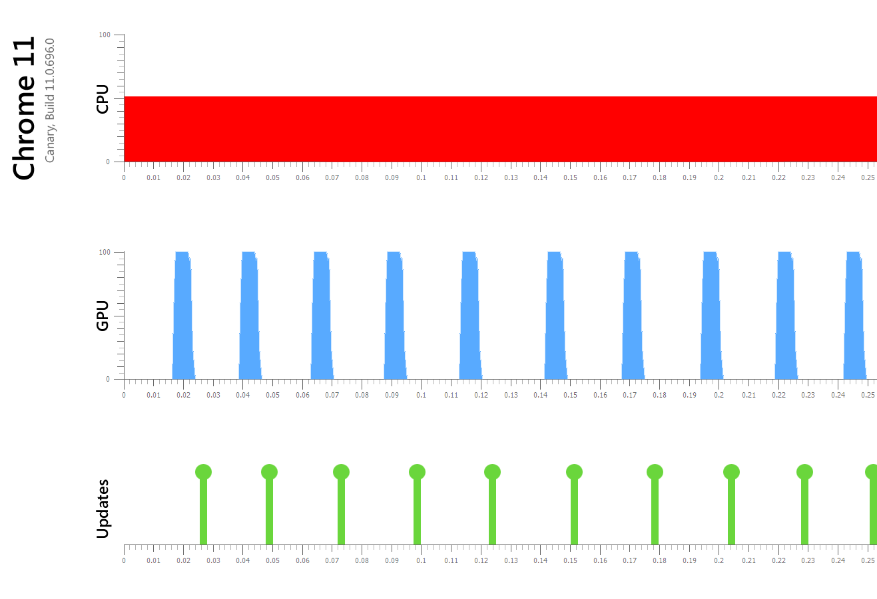
Comparing Hardware Accelerated SVG across Browsers with Santa’s Workshop

Slide 20
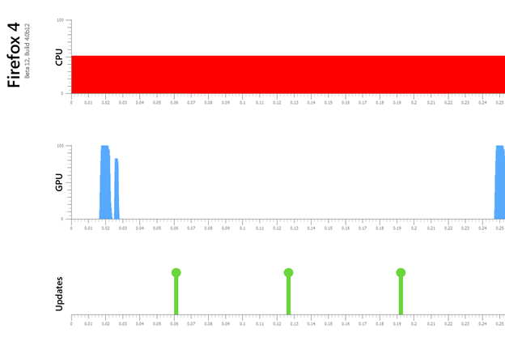
Comparing Hardware Accelerated SVG across Browsers with Santa’s Workshop

Slide 21
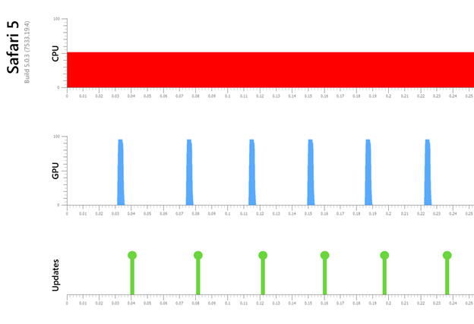
Comparing Hardware Accelerated SVG across Browsers with Santa’s Workshop

Slide 22
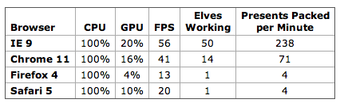
Comparing Hardware Accelerated SVG across Browsers with Santa’s Workshop

